Slide 1
Sacramento Real Estate: Finding Average
Shawn Cavazos, Edward Michaud, Amara Hamadache
5/08/2021

Slide 2

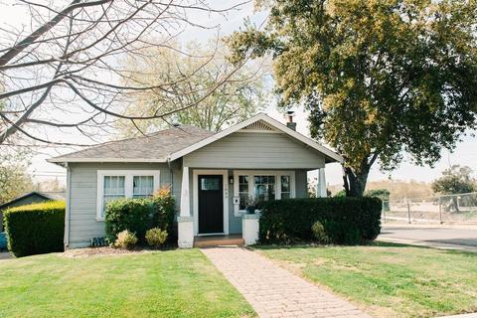
The Scenario:

Slide 3
How do we satisfy the request?
Locate and clean the Data
What are the common metrics for the average home purchase
Create bins of data to represent common breakpoints
Create visual aides to guide our home buyer
Identify current trends in the market
Identify/Eliminate outliers
Using median or mean?

Slide 4
Overall Game plan
First, Locate and clean the data
Next, we analyze the data and create practical depictions
Finally, our conclusions are presented to the client

Slide 5
Initial setup:
Various dependencies were added such as matplot, pandas, pprint, numpy, seaborn, scipy, and csv.
Next, the csv file was added to the script. It was then tested to be read in the script.
Then, it was cleaned up, there would be no repetitive locations or places that were given a value of zero in square foot.

Slide 6
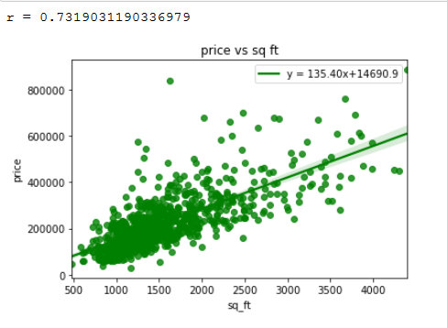
Making the Scatter plot graph:
A graph from square foot to its price was first created.
This shows how more people would settle around the 1000-2000 square foot mark and pay around $200,000-$300,000 range.
It becomes less popular to buy housing that is around $400,000 - $600,000 range when the square foot amount increases.
Our client is willing to purchase a house that is about $207,000 and is about 1500 Square feet after viewing the data.

Slide 7
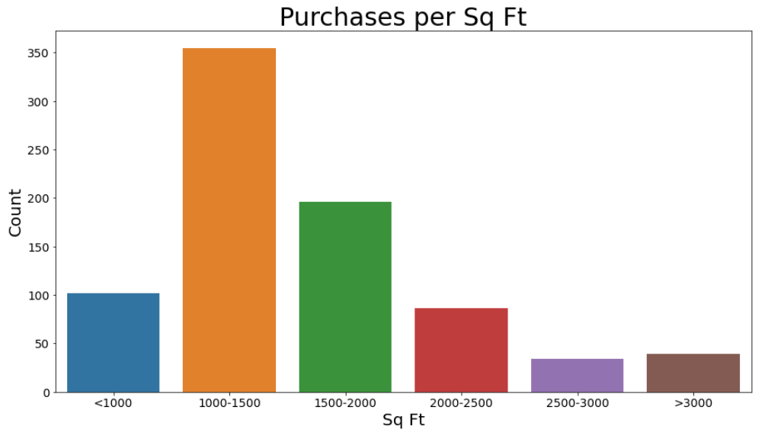
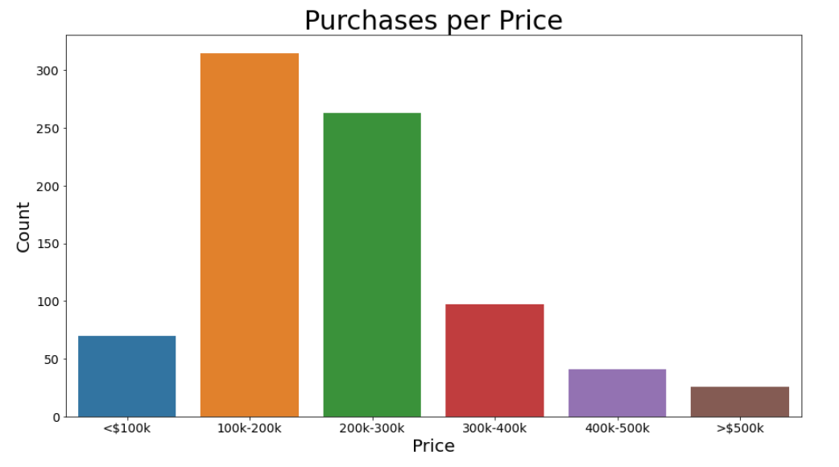
Making a bar graph
A bar graph was used to depict the occurrences of purchase of houses and their price range.
Information about how many purchases were made Per square foot.
Information about purchases per zip code was also presented.
A bar graph for purchases per day was then created.
Another bar graph was made for bedroom count.
The client was willing to buy a house with 3 Bedrooms

Slide 8
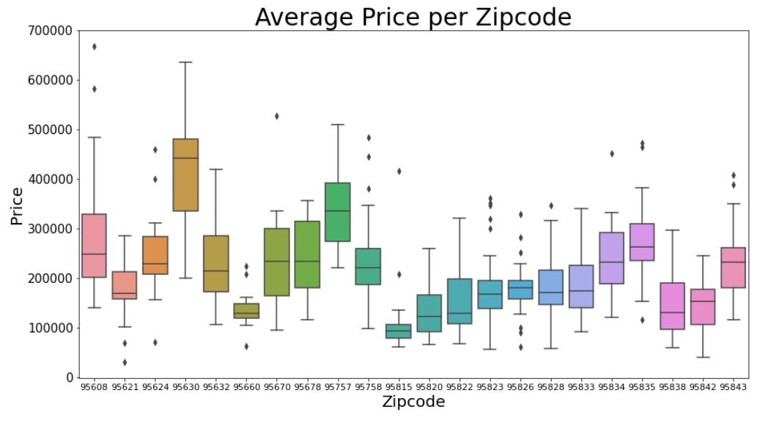
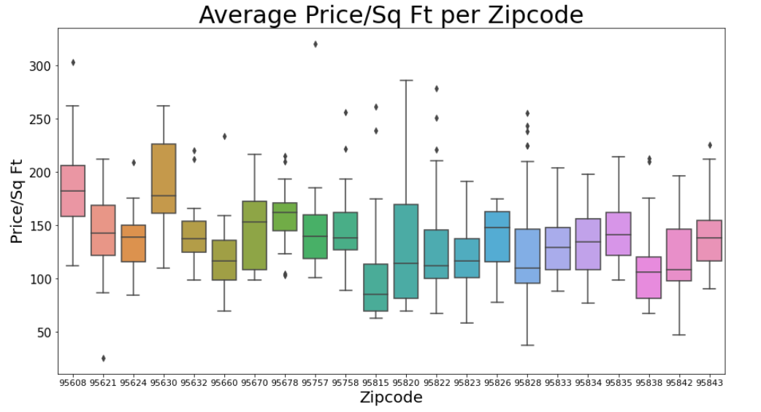
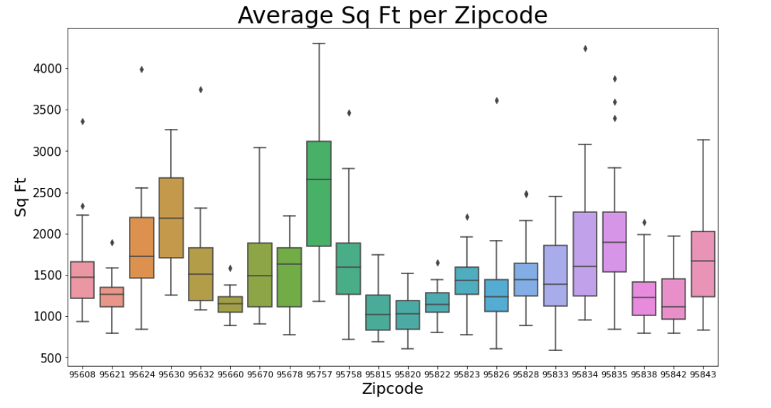
Making a box graph
A box graph made with whiskers was used to find variation between zip codes.
Boxes represented the mean and the lines are the highest/lowest outliers.
One was made for average price, another for average square foot, and average price per sqr foot.
The client was interested in living in the area with zip code 95823.

Slide 9
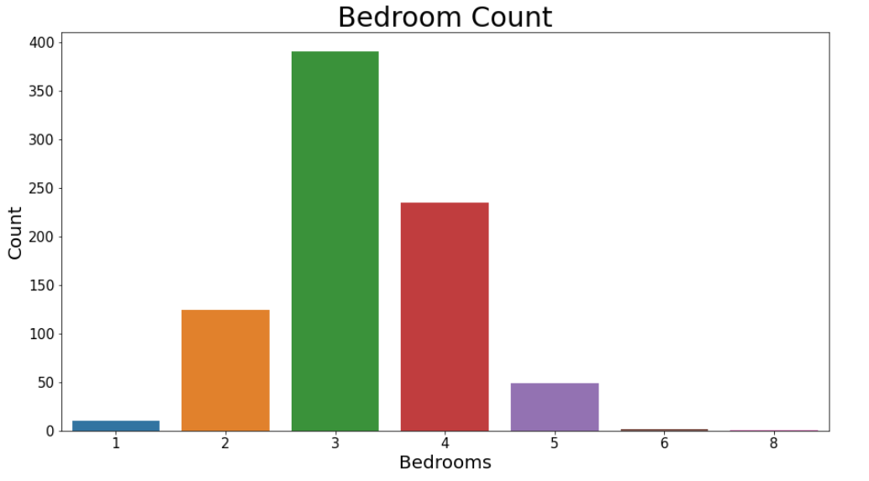
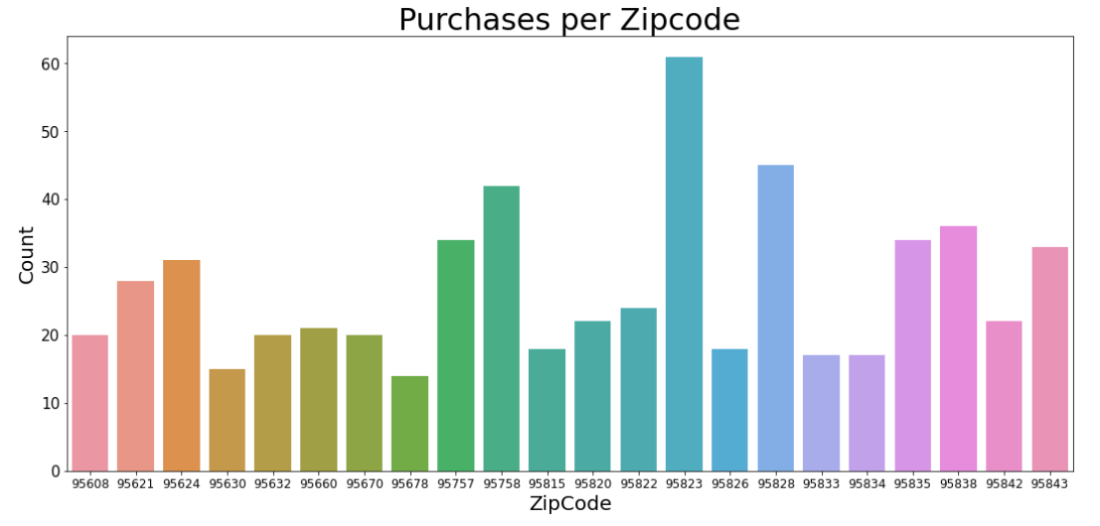
Bar graphs
Bedroom count:
3-bedroom houses are the most purchased
followed by 4-bedroom
Purchases per zip code
The most purchases were made In the zip code 95823

Slide 10
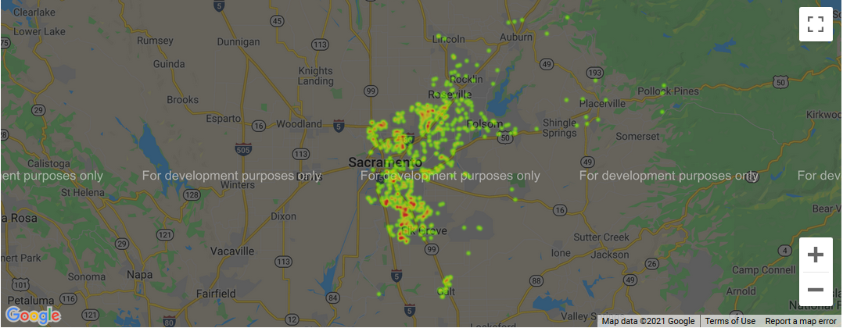
Heat Map This heatmap shows where in Sacramento are most of the purchases were being made

Slide 11
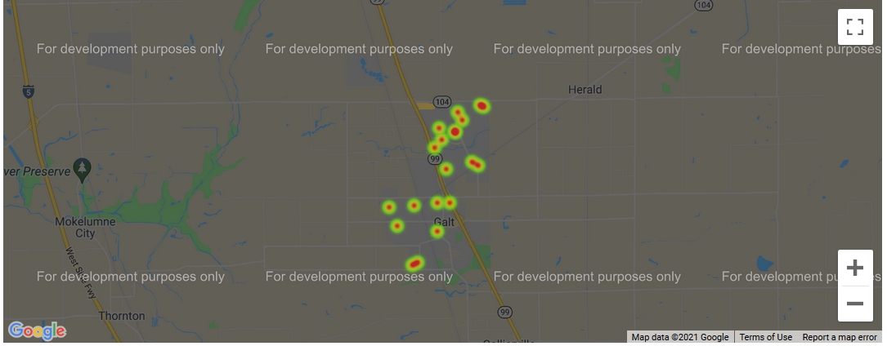
Heat Map This heatmap shows the location of the houses in the average zip code which is 95632

Slide 12
Conclusion:
Our client can choose around the average houses which is:
$ 214,000
1500 sq ft
3 bedrooms
the most popular zip code 95823
the most average zip code 95632

Slide 13

Summary and Questions

